Slide 1
CHAPTER – 5 PLANT TISSUE CULTURE

Slide 2
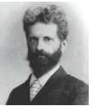
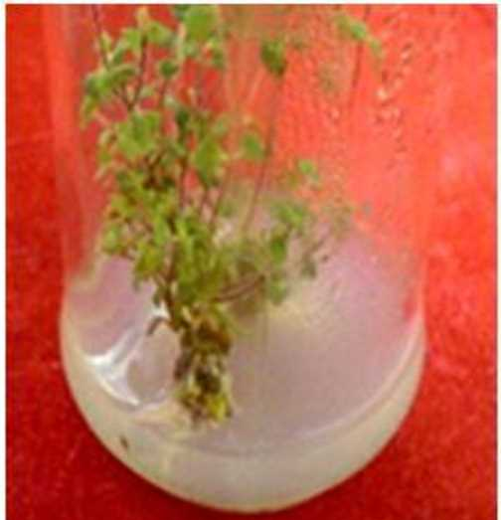
INTRODUCTION
Growing plant protoplasts, cells, tissues or organs away from their natural environment and under artificial condition is known as tissue culture.
It is also known as invitro growth of plant protoplasts, cells, tissues and organs.
Father of plant tissue culture is Gottlieb Haberlandt.
He proposed the concept of Totipotency and cultured Lamium purpureum in artificial culture medium.

Slide 3
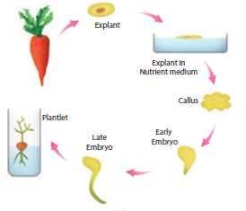
Basic concepts of tissue culture
Totipotency: regenerate into a whole plant
Differentiation : the process of biochemical and structural changes –cells become specialized in form and function.
Redifferentiation : already differentiated cell into another type of cell
Dedifferentiation : reversion of mature cells to the meristematic state leading to the formation of callus
TOTIPOTENCY

Slide 4
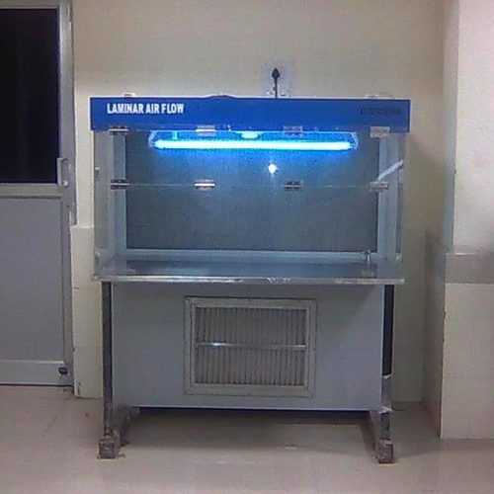
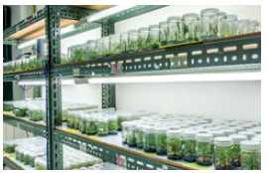
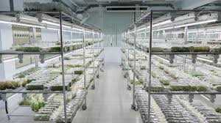
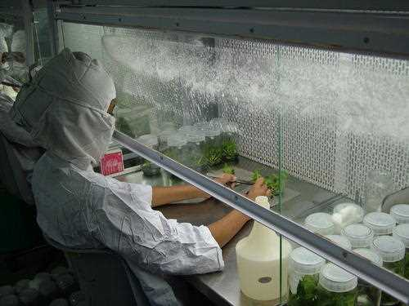
Plant tissue culture & LAB FACIlity
Invitro and aseptic growth of any plant part on medium
Explant
PTC lab should contain:
Washing facility for washing and drying glasswares
Autoclave, pH meter and electronic balance
LAF cabinet
Proper illuminated chamber with humidity maintained at 60%
Laminar Air flow
PTC room

Slide 5
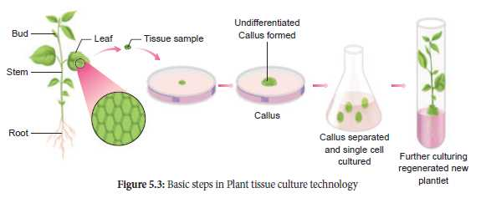
MEDIA PREPARATION AND CULTURE CONDITION
pH – 5.5-6.0
Temperature – 25C
Humidity and light intensity – 50-60%, 1000lux
Aeration - shakers

Slide 6
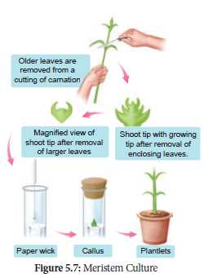
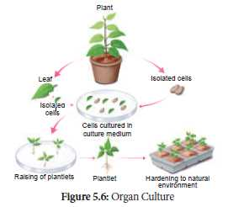
Types of culture
Meristem culture
Organ culture
callus

Slide 7
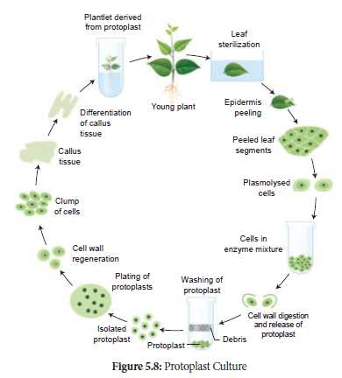
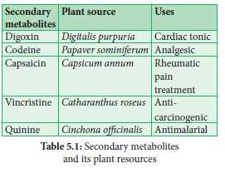
Types of culture
Protoplast culture
Cell suspension culture

Slide 8
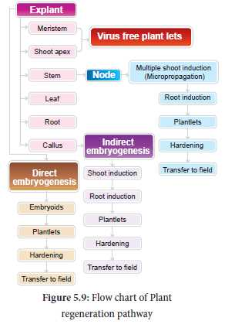
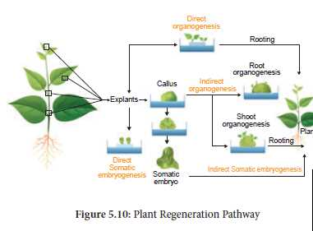
Plant regeneration pathways
Somatic embryogenesis
Somatic embryogenesis is the formation of embryos from the callus tissue directly and these embryos are called Embryoids or from the in vitro cells directly form pre-embryonic cells which differentiate into embryoids.
Organogenesis
The morphological changes occur in the callus leading to the formation of shoot and roots is called organogenesis.

Slide 9
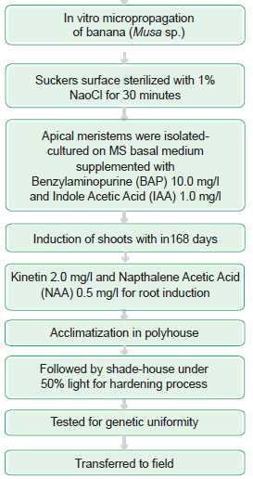
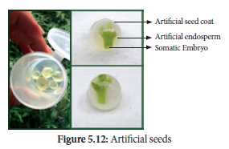
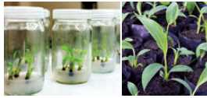
applications
Micro propagation of banana
Artificial seed

Slide 10
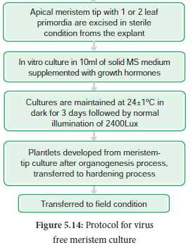
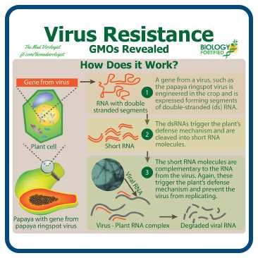
applications
Virus free plants
Virus resistant plant

Slide 11
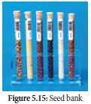
Germplasm conservation
Germplasm conservation refers to the conservation of living genetic resources like pollen, seeds or tissue of plant material maintained for the purpose of selective plant breeding, preservation in live condition and used for many research works.

Slide 12
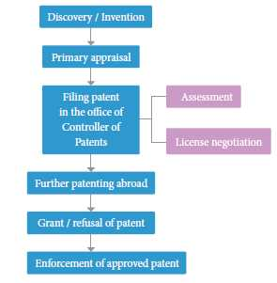
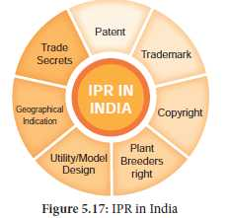
Intellectual property rights
IPR
Patents
Biosafety
Bioethics
Biosafety – prevention of large scale loss of biological integrity,focusing both on ecology and human health.
Risks: pathogenicity,toxicity, increase in number of antibiotic resitant microbes
Disposal
Safety aspects – discard, contamination and mutation.
ELSI
Ethical issuesemerging from advances in biology and medicine
Their mission is to identiyand address issuesraised by genomic research that would affect individuals.

Slide 13
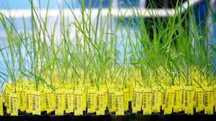
Thank you

